Slide 1
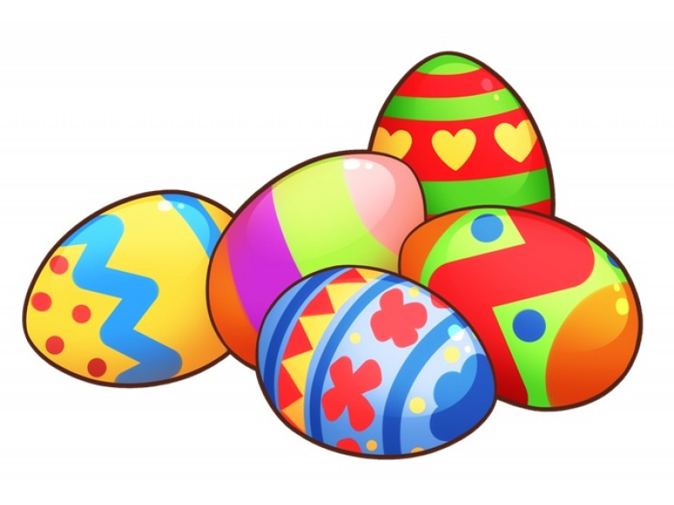
Easter 2019 Maths Quiz
By Solutions Education

Slide 2
Easter 2019 Maths Quiz
Contents:
Questions 1-10: Maths multiple choice questions with Fun Facts!
Questions 11-20: Anagrams (mixture of maths keywords and Easter/Chocolate words)
Questions 21-25: Problem Solving
Questions 26-30: Hidden Chocolates
ANSWERS

Slide 3
ROUND 1
FUN FACT – MATHS QUESTIONS

Slide 4
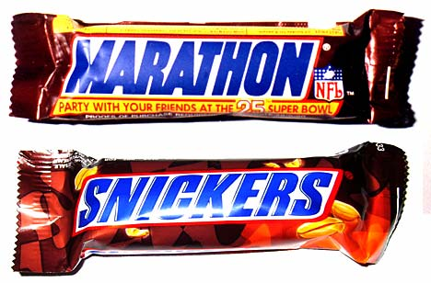
Question 1
Fun Fact: Did you know that Snickers used to be called Marathon?
What is the simplified probability of randomly picking an “A” from the word “Marathon”?
A: 2/6
B: 2/8
C: 1/4
D: 1/6

Slide 5
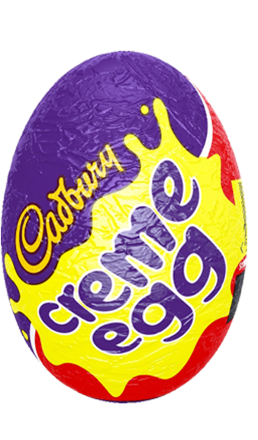
Question 2
Fun Fact: Over 500 million Crème Eggs are produced each year.
If ¾ of the 500 million Crème Eggs are sold in the UK. How many million would that be?
A: 400
B: 375
C: 350
D: 425

Slide 6
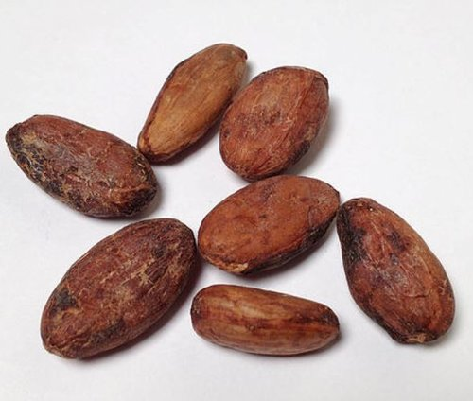
Question 3
Fun Fact: It takes 400 cocoa beans to make 1 pound of chocolate.
How many pounds of chocolate can be made with 32,000 cocoa beans?
A: 800
B: 80
C: 900
D: 90

Slide 7
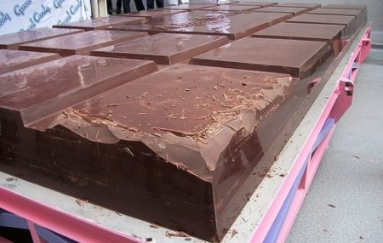
Question 4
Fun Fact: The largest chocolate bar ever produced was 4 metres long and weighed 5792.5kg.
Write 5792.5 in standard form?
A: 5.7925 x 10⁴
B: 5.7925 x 10⁻³
C: 5.7925 x 10⁻⁴
D: 5.7925 x 10³

Slide 8
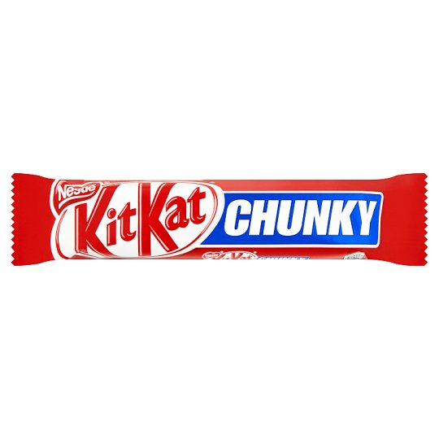
Question 5
Fun Fact: Kit Kat Chunky first launched in 1999.
If a Kit Kat Chunky is 40g and sold for 75p, write the weight to cost as a simplified ratio?
A: 1 : 1.875
B: 15 : 8
C: 8 : 15
D: 40 : 75

Slide 9
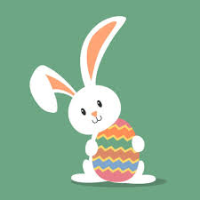
Question 6
Fun Fact: The Easter Rabbit used to be the Easter Hare!
Rabbits can jump 5.8 feet. If a rabbit took 16 jumps of this length, estimate the total length.
A: 90 feet²
B: 92.8 feet
C: 92.8 feet²
D: 90 feet

Slide 10
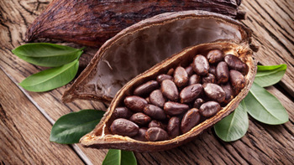
Question 7
Fun Fact: Chocolate dates back to 350BC.
Approximately, how many years ago was Chocolate discovered?
A: 2,470
B: 2,370
C: 1,670
D: 2,270

Slide 11
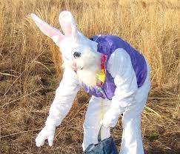
Question 8
Fun Fact: Leporiphobia is the fear of rabbits!
If 0.9% of people had leporiphobia, what is this as a fraction?
A: 9/10
B: 9/100
C: 9/1000
D: 9/10000

Slide 12
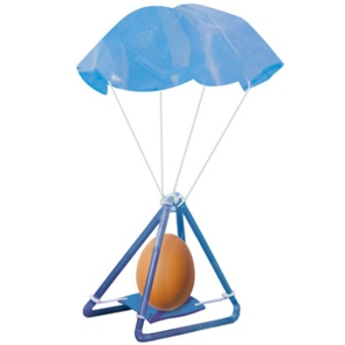
Question 9
Fun Fact: The greatest height from which fresh eggs have been dropped to earth is 213m.
What is 213 metres in km?
A: 2.13 km
B: 0.0213 km
C: 21.3 km
D: 0.213 km

Slide 13
Question 10
Fun Fact: Feeding chocolate to rabbits is a bad idea.
Share 48 eggs between Roger and Peter in the ratio 5:3.
A: 10:6
B: 30:18
C: 32:16
D: 5:3

Slide 14
ROUND 2
ANAGRAMS

Slide 15
Questions 11-20
Work out these maths and Easter/chocolate anagrams (a point for each)
11. MAC LIED
12. BOLT RONEE
13. AM NERDIER
14. A REST E
15. HANDOUTS
16. BONNIER DUKE
17. ALTERING
18. BEDROCK ELUDE
19. CLEANSE
20. OFFICE STREP

Slide 16
ROUND 3
PROBLEM SOLVING

Slide 17
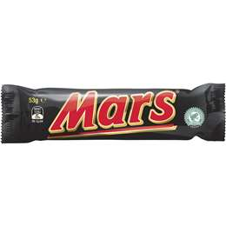
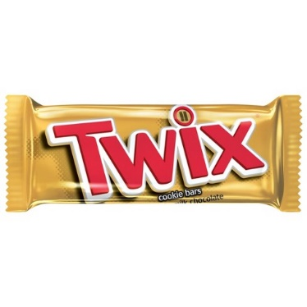
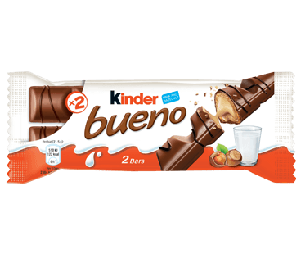
Questions 21
Work out the costs for each Chocolate Bar (a point for each).
= £1.83
= £1.75
= £1.82

Slide 18
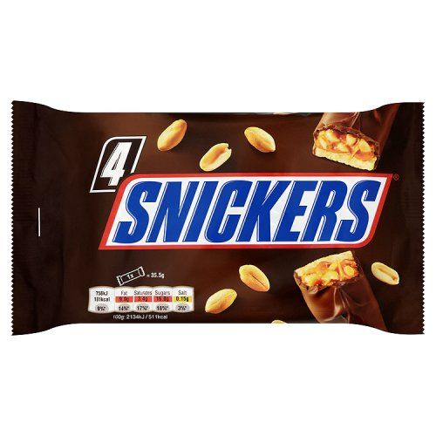
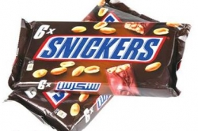
Questions 22
Which is the best value?
Option A
6 Bars for £2.16
Option B
4 bars for £1.40

Slide 19
Questions 23
A bunny population, starting at 220 bunnies, is growing at a rate of 55 bunnies per week. After end of the 6th week how many bunnies are there?

Slide 20
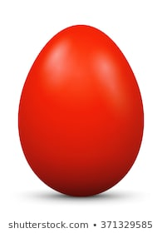
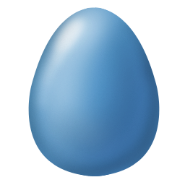
Questions 24
The Easter bunny has a red egg, a blue egg and a green egg to give out in any order he chooses.
How many different orders could he create?

Slide 21
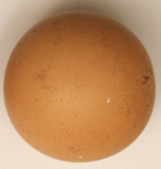
Questions 25
A perfectly round egg has a Circumference of 18cm. If pi is approximately 3, what is the eggs radius?

Slide 22
ROUND 4
HIDDEN CHOCOLATE

Slide 23
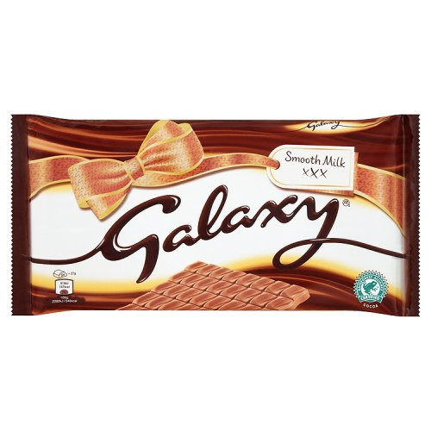
Questions 26
Name the hidden chocolate bar

Slide 24
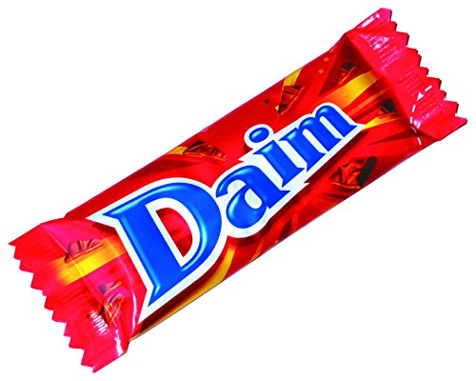
Questions 27
Name the hidden chocolate bar

Slide 25
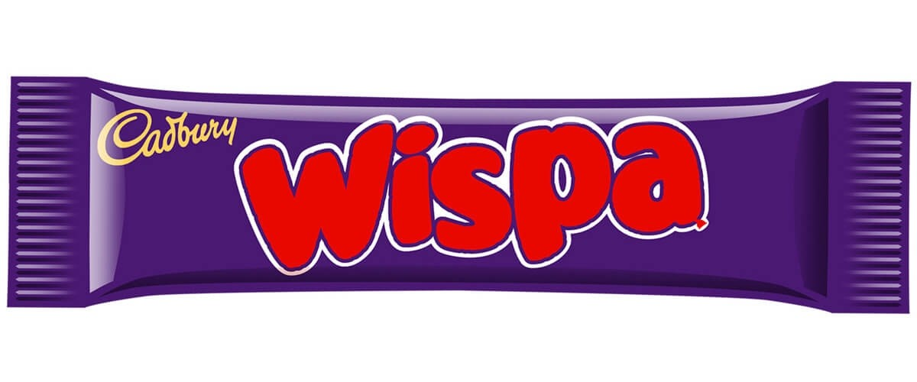
Questions 28
Name the hidden chocolate bar

Slide 26
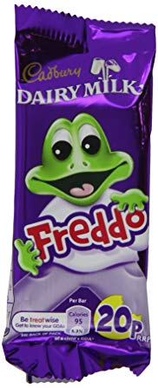
Questions 29
Name the hidden chocolate bar

Slide 27
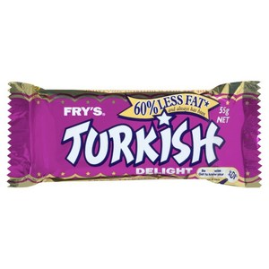
Questions 30
Name the hidden chocolate bar

Slide 28
ROUND 1 ANSWERS
FUN FACT – MATHS QUESTIONS

Slide 29
Question 1 ANSWERS
Fun Fact: Did you know that Snickers used to be called Marathon?
What is the simplified probability of randomly picking an “A” from the word “Marathon”?
A: 2/6
B: 2/8
C: 1/4
D: 1/6

Slide 30
Question 2 ANSWERS
Fun Fact: Over 500 million Crème Eggs are produced each year.
If ¾ of the 500 million Crème Eggs are sold in the UK. How many million would that be?
A: 400
B: 375
C: 350
D: 425

Slide 31
Question 3 ANSWERS
Fun Fact: It takes 400 cocoa beans to make 1 pound of chocolate.
How many pounds of chocolate can be made with 32,000 cocoa beans?
A: 800
B: 80
C: 900
D: 90

Slide 32
Question 4 ANSWERS
Fun Fact: The largest chocolate bar ever produced was 4 metres long and weighed 5792.5kg.
Write 5792.5 in standard form?
A: 5.7925 x 10⁴
B: 5.7925 x 10⁻³
C: 5.7925 x 10⁻⁴
D: 5.7925 x 10³

Slide 33
Question 5 ANSWERS
Fun Fact: Kit Kat Chunky first launched in 1999.
If a Kit Kat Chunky is 40g and sold for 75p, write the weight to cost as a simplified ratio?
A: 1 : 1.875
B: 15 : 8
C: 8 : 15
D: 40 : 75

Slide 34
Question 6 ANSWERS
Fun Fact: The Easter Rabbit used to be the Easter Hare!
Rabbits can jump 5.8 feet. If a rabbit took 16 jumps of this length, estimate the total length.
A: 90 feet²
B: 92.8 feet
C: 92.8 feet²
D: 90 feet

Slide 35
Question 7 ANSWERS
Fun Fact: Chocolate dates back to 350BC.
Approximately, how many years ago was Chocolate discovered?
A: 2,470
B: 2,370
C: 1,670
D: 2,270

Slide 36
Question 8 ANSWERS
Fun Fact: Leporiphobia is the fear of rabbits!
If 0.9% of people had leporiphobia, what is this as a fraction?
A: 9/10
B: 9/100
C: 9/1000
D: 9/10000

Slide 37
Question 9 ANSWERS
Fun Fact: The greatest height from which fresh eggs have been dropped to earth is 213m.
What is 213 metres in km?
A: 2.13 km
B: 0.0213 km
C: 21.3 km
D: 0.213 km

Slide 38
Question 10 ANSWERS
Fun Fact: Feeding chocolate to rabbits is a bad idea.
Share 48 eggs between Roger and Peter in the ratio 5:3.
A: 10:6
B: 30:18
C: 32:16
D: 5:3

Slide 39
ROUND 2 ANSWERS
ANAGRAMS

Slide 40
Questions 11-20 ANSWERS
Work out these maths and Easter/Chocolate anagrams (a point for each)
11. MAC LIED - DECIMAL
12. BOLT RONEE - TOLBERONE
13. AM NERDIER - REMAINDER
14. A REST E - EASTER
15. HANDOUTS - THOUSAND
16. BONNIER DUKE – KINDER BUENO
17. ALTERING – TRIANGLE
18. BEDROCK ELUDE – DOUBLE DECKER
19. CLEANSE – SCALENE
20. OFFICE STREP – TOFFEE CRISP

Slide 41
ROUND 3 ANSWERS
PROBLEM SOLVING

Slide 42
Questions 21 ANSWERS
Work out the costs for each Chocolate Bar (a point for each).
= £1.83
= £1.75
= £1.82
Mars Bar = 61p (£0.61)
Twix = 57p (£0.57)
Kinder Bueno = 64p (£0.64)

Slide 43
Questions 22 ANSWERS
Which is the best value?
Option A – 36p each
6 Bars for £2.16
Option B – 35p each
4 bars for £1.40

Slide 44
Questions 23 ANSWERS
A bunny population, starting at 220 bunnies, is growing at a rate of 55 bunnies per week. After end of the 6th week how many bunnies are there? 550

Slide 45
Questions 24 ANSWERS
The Easter bunny has a red egg, a blue egg and a green egg to give out in any order he chooses.
How many different orders could he create? 6

Slide 46
Questions 25 ANSWERS
A perfectly round egg has a Circumference of 18cm. If pi is approximately 3, what is the eggs radius?
18/3 = 6
6/2 = 3cm

Slide 47
ROUND 4 ANSWERS
HIDDEN CHOCOLATE

Slide 48
Questions 26 ANSWERS
Name the hidden chocolate bar
GALAXY

Slide 49
Questions 27 ANSWERS
Name the hidden chocolate bar
DAIM

Slide 50
Questions 28 ANSWERS
Name the hidden chocolate bar
WISPA

Slide 51
Questions 29 ANSWERS
Name the hidden chocolate bar
FREDDO

Slide 52
Questions 30 ANSWERS
Name the hidden chocolate bar
TURKISH DELIGHT

